Slide 1
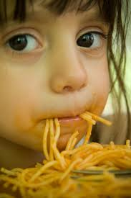
Time to Talk
Make the most of mealtimes

Slide 2
Question Time!
What helps children to enjoy mealtimes?
Sitting with them
Offering some choices
Talking about what they are tasting
All of the above!

Slide 3
Did You Know?
Shared mealtimes can help your child with learning to talk
To find out more go to: http://www.wordsforlife.org.uk/family-mealtime-chat

Slide 4
True or False?
When babies are born, they are most interested in looking at faces
True
Yes, that’s right! Their eyes can see about as far as your face when you are holding them
False
Oops. Try again!
Notes:
This page could be “lift the flaps”

Slide 5
True
Lift the flap to see if you are right!
False
Lift the flap to see if you are right!
Notes:
Flaps to stick on to previous page.

Slide 6
Top Tip
Sit face to face

Slide 7
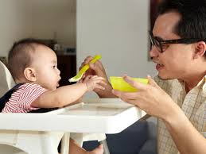
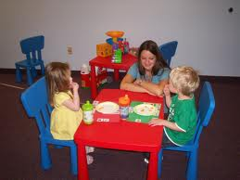
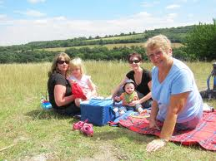
Make the most of mealtimes
There are lots of great ways to be face to face at mealtimes
use a highchair...
or a low table...
or have a picnic!

Slide 8
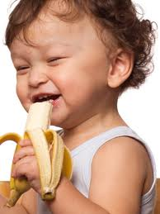
Mealtimes are great for looking at faces!
You can give me the words for what I am tasting
oooh...
lovely banana!
juicy!
yummy!
tasty!
watermelon!
Stay face to face… look at my expressions!

Slide 9
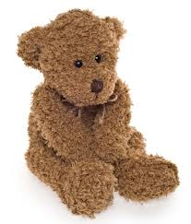
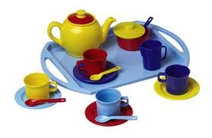
Let’s have a tea party
Offer two choices and wait for your child to look, reach, point or talk
Sitting face
to face helps your
child see and hear
you clearly
apple or banana?
water or milk?
Sitting face to
face helps you see
and hear how your
child responds
Sit face to face to help me learn to choose

Slide 10
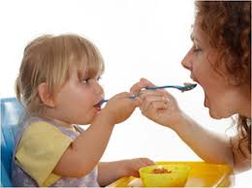
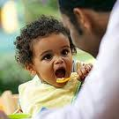
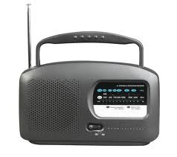
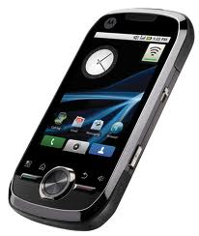
Talk at tea-time
Mealtimes are great for chatting about your day
Family meals are
important for lots
of different cultures
– whatever is on the
menu!
Eating together helps children learn to be sociable and to try new foods
Sit face to face – reduce distractions as much as you can
Phones, radio and tv in the background can make it difficult for children to concentrate
Notes:
This page could be made as a lift the flaps (i.e. the bug on the flap, the words underneath).

Slide 11
Time to Talk Champion
Photo
Do you have questions about your child’s talking?
Have a chat with me!

